Slide 1
Excel and Power bi dashboards

Slide 2
Developed an interactive sales dashboard for Olist store using a 100,000-row dataset, revealing key insights into payment methods, shipping, and product trends.
Analysed payment data, highlighting credit card dominance (R$15.17M revenue, 96,476 orders), and evaluated shipping efficiency, identifying an 11-day average shipping time with Pet Shop.
Conducted geographic and correlative analyses, identifying top-selling product categories (e.g., watches gifts, sports leisure) and correlating shipping/order volume with customer reviews to inform service improvements.
Leveraged data-driven insights to inform strategic decisions across sales, marketing, and logistics, contributing to business growth and customer satisfaction.

Slide 3
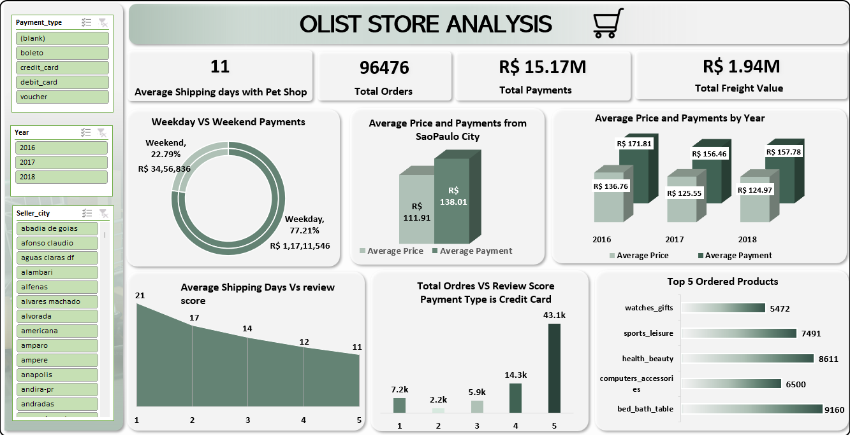
EXCEL DASHBOARD

Slide 4
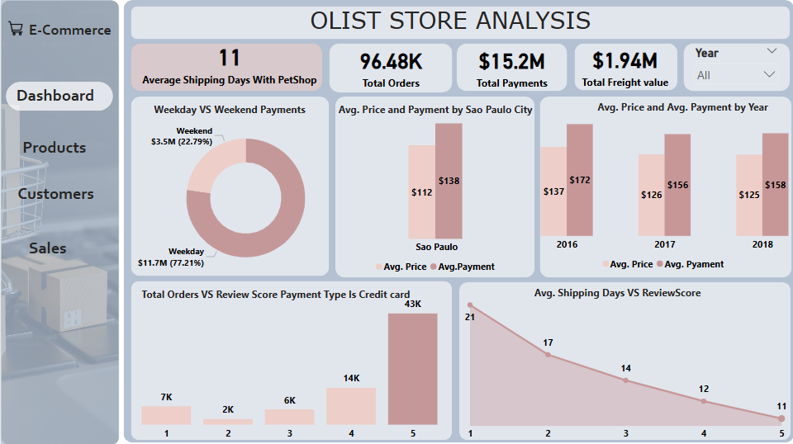
POWER BI DASHBOARD

Slide 5
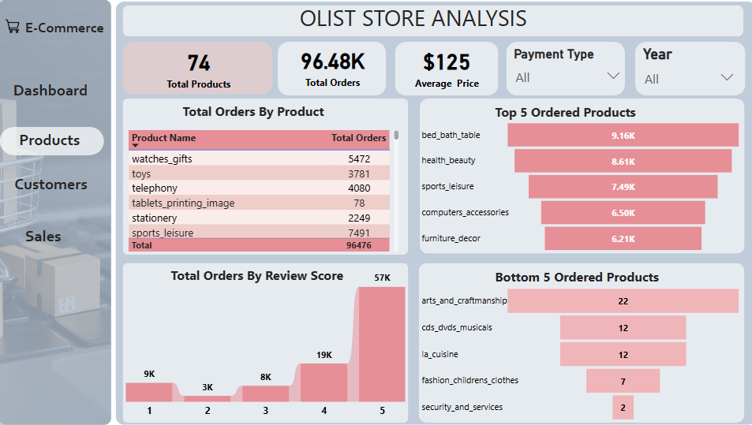

Slide 6
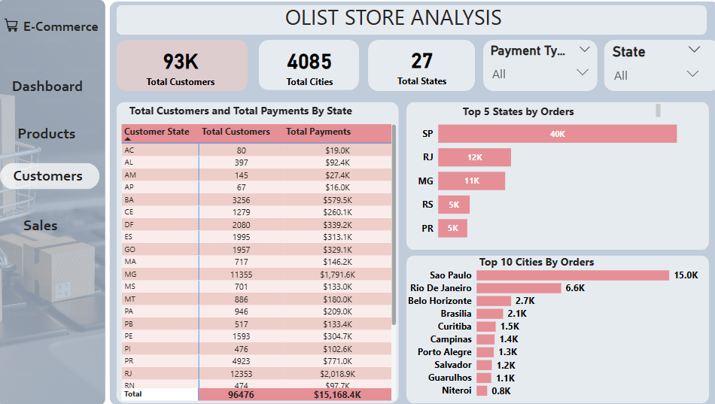

Slide 7
